Slide 1
Working with Containers

Slide 2
Traditional Deployment Method
Before going to Containers let’s first look traditional deployment:
Code was build and tested on Dev machines
Then copied on the production server
Many times code do not works on production servers but was working on Dev server
This makes issues like “It was working on my machine”
Tohis used to happen due to multiple dependiencies in different environments

Slide 3
What is Container
Thin packaging model
They Package together software, its dependencies, and configuration files
Can be copied between machines
Uses the underlying operating system
This package creates an atomic unit that can be executed
Completely independent from the rest of machine it is hosted on

Slide 4
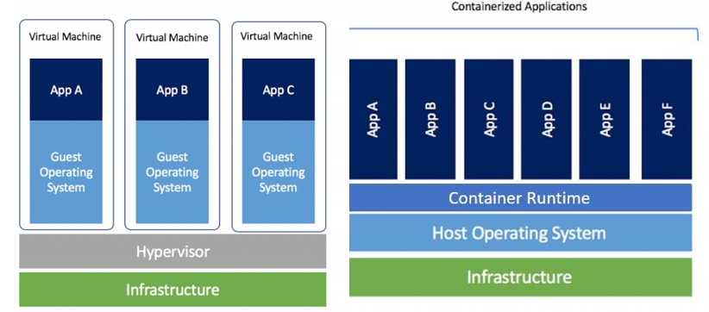
Container vs VM
VM
Each VM have its own OS
Each VM can have diff OS like windows, linux, etc
VM acts like a complete system/server within itself as it has own complete OS
Container
Very lightweight in comparison to VM
Use shared OS from the host
Container can only have same OS as of host, if host is windows server 2016, then all containers on can only have windows 2016

Slide 5
Why Containers
Predictability
Same package that was deployed in Dev can be used in Prod
No more issues like, it was working on another machine
Performance
Containers goes up within seconds vs minutes in case of VM
As VM need to boot up whole OS to start the application whereas container only need to execute the application as Host OS is already running which save time and resources
Density
Same size of server(H/W) can host several containers vs dozens of VMs
Isolation
One of drawback is, as container share same OS so so isolation between containers is much lighter then VM which makes it much easier to cross boundaries between containers
Preferred to use VM more sensitive data

Slide 6
Working with Containers
Containers have become extremely popular in recent years
Allow isolation, host density, single code base
App Engine Flexible Environment works with containers
GCP supports two services for running containers:
Cloud Run
Google Kubernetes Engine (GKE)

Slide 7
Docker
The most popular container environment
Released in 2013
Docker uses containerization technology to package applications and their dependencies into containers, ensuring that they run consistently across different environments
Docker allows you to version control your container images

Slide 8
Components of Docker
The Docker server also called as Docker Daemon, Heart of Docker
This is the service that runs on server and responsible for managing Docker containers
It turns containers on or off
It builds containers based on images, and it exposes API for management tools.
Images :- It is the set of definitions and software for a container to run.
It is similar to a VM machine Image
images are static files and they don't run.
Images are the building blocks of the containers.
Container Registry :- a collection of images from where you can pull the image you want
Can be public or private
Container:- A container is an image that is built and run.
Client:- is a CLI command line interface, is where you can send instructions to the daemon

Slide 9
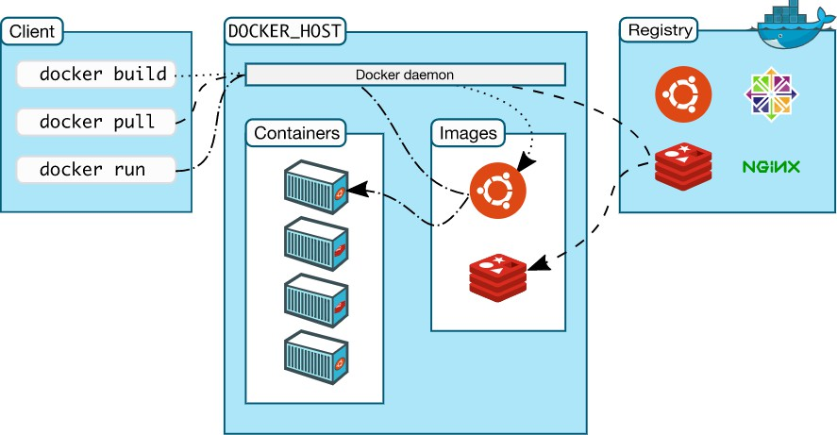
Docker Architecture
The Docker Server
CLI to manage the images and containers
Images of the containers, containing the software to run
Repositories of images. Can be public or private
Instances of Images
https://docs.docker.com/get-started/overview/

Slide 10

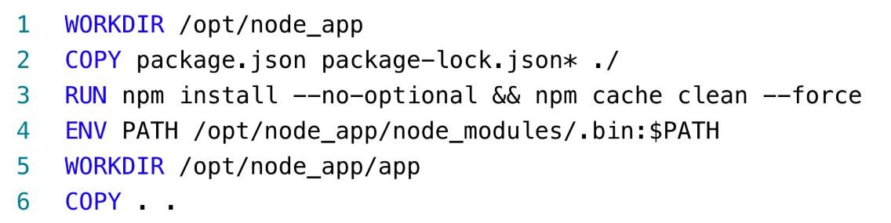
Dockerfile
Contains instructions for building custom images
https://www.docker.com/blog/keep-nodejs-rockin-in-docker/

Slide 11
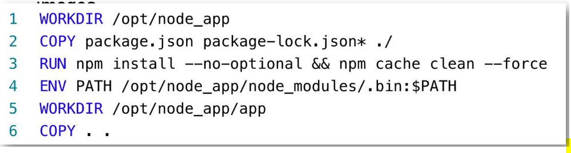
DockerFile
As we know customization of Images is one of core capability of Docker
Docker File is a file that contains instructions of building custom images
It can instruct the Docker daemon to copy files, run commands, change working directory, and more.
Docker files are usually quite small because there are so many baseline images to begin from, and the customization required is not that big.

Slide 12
Artifact Registry
GCP registry for Docker images and software packages
Reliable and fast
Easy to maintain
Regional and multi-regional
Can store artifacts from Cloud Build
Supported Formats
Docker Images
Language packages:- Java, Node,js, Python, Go
OS Packages:- Debian, RPM

Slide 13
Artifact Registry Integration and Pricing
Integrates with:
Compute Engine
App Engine Flexible Environment
Cloud Run
Google Kubernetes Engine (GKE)
Pricing
Price as per storage used by stored files
First 0.5GB is free
After that $0.10/GB/month

Slide 14
Lab-1 Create Artifact Registry Repository

Slide 15
Cloud Run
Managed compute platform for running containers
Pulls images from various registries and best integration with Artifact Registry
Auto scaling, so we dot not need to deal with amount of instances that support our container
Traffic management between revisions, similar to what we saw with App engine versions
SLA 99.95%
Can be Public(accessible from internet) or Private(Accessible only from internal resources)
Users can use any programming language to build their application

Slide 16
Cloud Run
It can support services and Jobs
Services can basically
Respond to web requests
Used for web apps, web APIs, etc
Jobs can do below:-
Run code that performs a work and quit once work is done
Jobs do not listen to outside requests (only works as per code)
Can be scheduled at a predefined time schedule
Generally used for data processing, migrations, etc
Note, most use cases for cloud run go for services

Slide 17
Cloud Run CPU Allocation
Two type of CPU allocation:-
Only during requests allocation
CPU is allocated to instance only when requests are incoming
Always allocated
CPU is always allocated even when there are no incoming requests
Note, use always allocated cpu for background processing

Slide 18
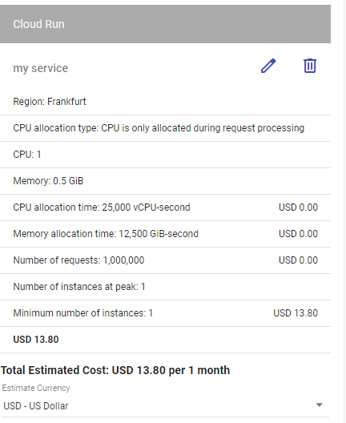
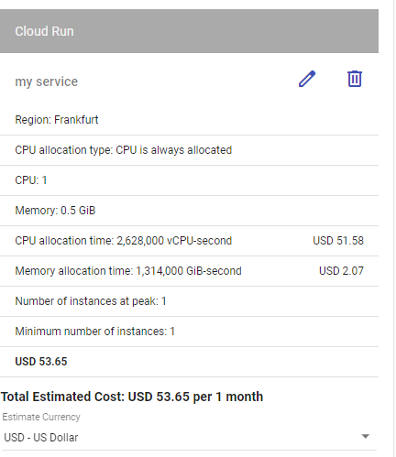
Cloud Run Pricing
Depends on the CPU Allocation configuration

Slide 19
Lab 2 Cloud Run service deploy

Slide 20
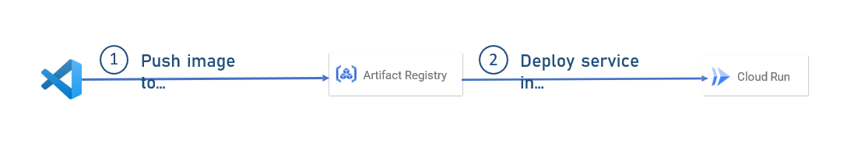
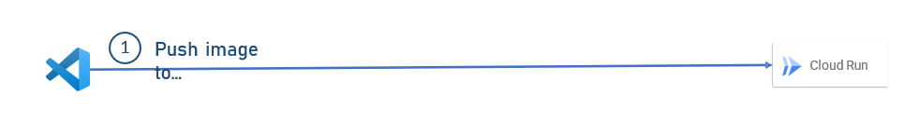
Deploying from Source
So far we deployed using cloud run in two steps
Step 1 – VS Code to Artifact registry
Step 2 – Deploy service in cloud run using image from Articatory
But with deploy from source we can do this in single step
We will directly push from VsCode to Cloud Run

Slide 21

Deploying from Source
Behind the Scenes A new repo will be created in Artifact Registry
Repo always named as cloud-run-source-deploy
Image is pushed the repo
Cloud run pulls the image from repo and run it
Basically this also has all the same components as previously used, only part is Artifactory part is hidden

Slide 22

Lab 3
Cloud Run service deploy from Source

Slide 23
Cloud Run Jobs
Previously we checked service part of cloud run, now let’s explore jobs part
Cloud Run can be used to run also jobs
Jobs is a unit of work that does something until work is done
Jobs can be scheduled

Slide 24
Lab -4
Explore options for Cloud Run Jobs

Slide 25
Containers Management
We already explored that Containers are a great deployment mechanism
But, what happens when there are too many of containers, how to manage them
Major problems are below:-
Deployment:- If there are lot of containers to be deployed, it can be time consuming and prone errors
Scalability :- We should be able to scale them or add more containers if required
Monitoring :- What happens if some container goes down
Routing :- If we have multiple instances of containers then we need a routing mechanism container-based a load balancer
High-Availability :- To make sure our container-based system can deal with crashed and errors
These problems are similar to instance management, for instances we use tools like load balancer, similarly we have tools for containers as well

Slide 26
Kubernetes
The most popular container management platform
Released by Google in 2014
Provides all aspects of management like:
Routing
Scaling
High-Availability
Automated Deployment
Configuration Management

Slide 27
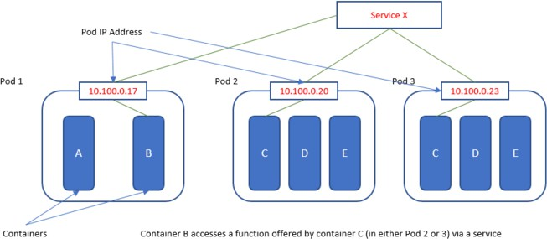
Kubernetes Architecture
https://en.wikipedia.org/wiki/Kubernetes
Notes:
As you can see in this diagram, the basic building block in Kubernetes is the pod.
Pod is the atomic unit in Kubernetes and it is the one Kubernetes manages.
You can think of Pod as a container of containers.
In other words, the Docker container lives inside a pod, and the pod functions as a wrapper around
it, provides connectivity and monitoring.
Now in the diagram you see there can be more than one Docker container inside a pod.
That's true, but rarely happens.
Usually there is one Docker container inside one pod.
As you can see, the pod exposes an IP address, which is how the Kubernetes communicates with the container.
The containers are accessible to the public network using service.
Service is the mechanism used by Kubernetes to expose functionality to the outside world, and it masks
the inner containers the service provides not just public IP, but also load balancing, monitoring,
high availability, and more.
Now, of course, there is a lot more in Kubernetes, but the pods and the service are the most important
part of it.

Slide 28
GKE (Google Kubernetes Engine)
Fully managed Kubernetes environment in GCP
Manages various Kubernetes components like
Cluster, Nodes, Pods etc
Major capabilities
Autoscaling
Platform management like upgrades, maintenance etc of Kubernetes versions
Security
Autor repair, if a pod goes down, GKE can restart it
Logging and monitoring
GKE SLA is 99%

Slide 29
GKE Editions
GKE has two editions
Standard
All basic capabilities
Runs on a single cluster
Autoscaling
Logging and monitoring
Enterprise
All Standard capabilities
Manages multi-cluster deployments:- we can distribute cluster across multiple regions
Team management:- allows different users different permissions on GKE
Buil-int Service Mesh :- Responsible for managing communication between various services
Works Also on AWS and Azure
Built on Anthos, which is a great product for managing multi-cluster kubernetes

Slide 30
GKE Modes
Along with editions, GKE has two modes as well
Standard
Manual configuration of Cluster, Nodes, Security, scaling, etc
Autopilot
Full Automated
Almost no configuration needed
SLA is 99.9% (by multiple zones deployment)
Most recommended

Slide 31
GKE Pricing
Standard
We pay price for underlying engine computes instances
Enterprise
We pay for the Anthos license
Autopilot
Pay for resources we actually use like vCPU, memory, disk

Slide 32
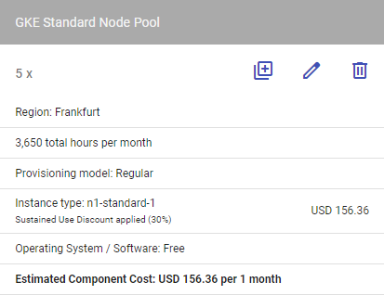
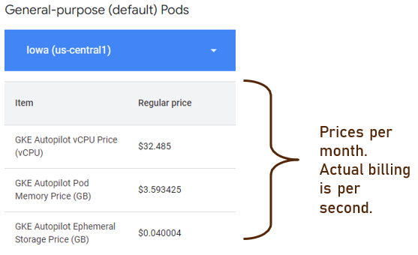
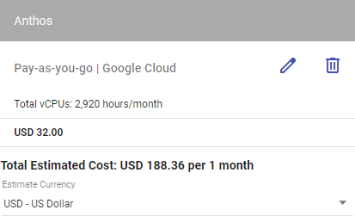
GKE Pricing
Autopilot
Enterprise
Standard

Slide 33
Lab-5
GKE Deployment

